Slide 1
CHAPTER 3
TRANSMISSION MEDIA

Slide 2
Cabling Specifications
IEEE 802
  LAN standards for data communications
ANSI/EIA/TIA 568
  Installation and termination of telephony and network cables. Also meets NEC specifications.
CE - European regulation

Slide 3
Introduction
Transmission Medium, or channel, is the actual physical path that data follows from the transmitter to the receiver.
Copper cable is the oldest, cheapest, and the most common form of transmission medium to date.
Optical Fiber is being used increasingly for high-speed applications

Slide 4
Types of Copper Cables
Coaxial cable
Unshielded Twisted Pair (UTP)
Shielded Twisted Pair (STP)
The cost of a cable is a function of the cost of the materials and of the manufacturing process. Thus, cables with larger diameter, involving more copper conductor and more insulation are more expensive than those with small diameter.

Slide 5
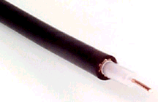
Coax Cable
A type of wire that consists of a center wire surrounded by insulation and then a grounded shield of braided wire which together form an electromagnetic field. The shield minimizes electrical and radio frequency interference.
2 Types of Coax Cable
Thick Coax (10Base5)
Thin Coax (10Base2)

Slide 6
10Base5 cable
Uses baseband transmission
Maximum data transfer speed is 10 Mbps
Maximum cable length is 500 meters
Solid Inner Conductor that is Rigid
Also known as
  Thick Ethernet or Thicknet or Thick Coax

Slide 7
10Base2 cable
This cable is thinner, with stranded inner conductor that is more flexible
Also known as
  Thin Ethernet or Thinnet
Operates at 10 Mbps
Uses baseband transmission
Maximum cable length is 200 meters
Cables in the 10Base2 system connect with BNC connectors

Slide 8
Coaxial Cable Applications
Primarily used for CATV since it provides a bandwidth of nearly one GHz into the home.
Coaxial cable is used for long distance, low attenuation and low noise transmission of information.
CATV based Internet delivery systems are growing.
The telephone companies also resort to coaxial cable to transmit 140 Mbps data signals between telephone switch buildings with a hop distance of up to 2 km.

Slide 9
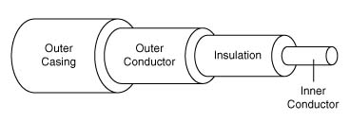
Coaxial cable

Slide 10
Unshielded Twisted Pair (UTP)
This is the copper media inherited from the telephony that is being used for increasingly higher data rates.
A twisted pair is a pair of copper wires that are twisted together and protected by a thin jacket.
UTP can be made with a variety of materials, sizes of conductors and numbers of pairs inside a single cable.
All UTP cables come in both solid and stranded filament. Solid filament cables are more rigid and usually intended for trunk cabling. Stranded filament cables are more pliable and generally targeted for patch cables.

Slide 11
UTP Cable: CAT 5 and CAT 6
CAT 5
  100Mbps data rate; Used in 100BaseT Ethernet and 155 Mbps ATM
CAT 5E and CAT 6
  Electrically backwards compatible with CAT 5
  CAT 6 assures at least double the channel bandwidth of CAT 5
  The bi-directional dual duplex transmission scheme employed by 1000Base-T actually requires each end of a CAT 6 cable to transmit on one conductor of each of the four pairs simultaneously

Slide 12
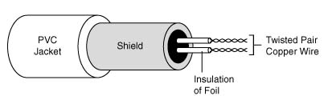
UTP Cable: CAT 7
Cat 7 cable rated at 600 Mbps features individually shielded or screened twisted pairs (STP or ScTP) of wires

Slide 13
UTP Cable: T-1
T-1
  Sometimes referred to as DS-1
  Two pairs of UTP 19 AWG wire
  Can be configured to carry voice or data traffic
  Bandwidth of 1.54 Mbps
  Fractional T-1s sold in increments of 64 kbps (56 kbps of throughput plus 8 kbps of overhead per channel)

Slide 14
Shielded Twisted Pair Cable (STP)
A 150 ohm cable composed of two copper pairs.
Each copper pair is wrapped in metal foil and then sheathed in an additional braided metal shield and outer jacket. The shielding absorbs radiation and reduces the EMI. As a result, STP can handle higher data speeds than UTP.
STP is used extensively by the telephone company for moving digitized information over distances of 2 km between repeaters, to span the distance of several miles between telephone company switching stations.
Notes:
The main drawback of STP is its high cost: although STP is less expensive than fiber optic cabling, it costs more than UTP

Slide 15
Attenuation
Reduction of signal strength during transmission
Attenuation is the opposite of amplification, and is normal when a signal is sent from one point to another
If the signal attenuates too much, it becomes unintelligible, which is why most networks require repeaters at regular intervals
Attenuation is measured in decibels

Slide 16

Attenuation
P_{O} is the output power
P_{I} is the input power

Slide 17
Factors that Influence Attenuation
Attenuation varies with:
Frequency
Resistance
Impedance
Echo
Crosstalk
EMI (Electro-Magnetic Interference)

Slide 18
Frequency
Attenuation increases with frequency
Ideally, all frequencies should undergo the same attenuation, but in reality, higher frequencies attenuate more than lower frequencies.

Slide 19
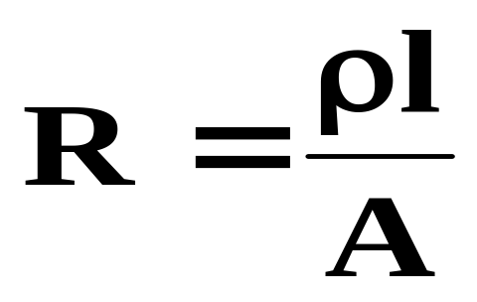
Resistance
Cable resistance depends upon the specific resistance or resistivity of the material, the length, and the cross-sectional area of the cable.
R= resistance in ohms
ρ = specific resistance in circular-mil ohms per foot
l = length of the conductor in feet
A= cross-sectional area in circular-mil

Slide 20
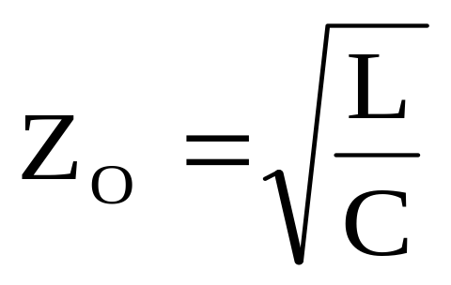
Impedance
Expressed in ohms, it can be defined as opposition to alternating current as a result of resistance, capacitance, and inductance in a component.

Slide 21
Echo
Echo or return loss is a reflection, that occurs when an electrical signal encounters an impedance irregularity.
The greater the distance from a source to an irregularity, the greater the time-delay in the reflected signal.

Slide 22
Crosstalk
Crosstalk refers to the amount of coupling between adjacent wire pairs, which occurs when a wire absorbs signals from adjacent wires.
Crosstalk is measured by injecting a signal into one pair and then measuring the strength of that signal on each of the other pairs in the cable.

Slide 23
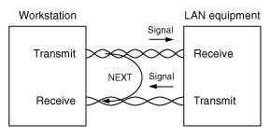
NEXT (Near End Crosstalk)

Slide 24
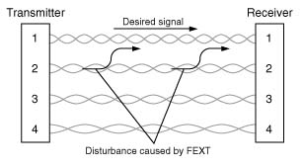
FEXT (Far End Crosstalk)

Slide 25
Electromagnetic Interference (EMI)
Electromagnetic Interference (EMI) is the result of electromagnetic (E/M) emissions. Every piece of electrically powered equipment transmits and receives E/M energy
Conductors are better antennas as the frequency increases
Since LANs operate at very high speeds there can be lots of problems due to EMI

Slide 26
Advantages of Copper over Fiber
Copper cable is about 30% cheaper than optical fiber cable
Copper does not require specialized personnel to install and test the equipment
Copper installation costs are lower
Copper networking hardware is around two to five times less expensive than fiber hardware

Slide 27
Fiber-Optic Cable
Transmits digital signals in the form of pulses of light
Optical Carriers are designated according to their transmission capacity
Attenuation is measured in dB/km, which today ranges from 0.2 to 2.0 dB/km

Slide 28
Fiber Construction
Fiber Construction
  Light travels through the inner layer called “core”
  Light is contained within the core by the outer layer called “cladding”
  Sizes of fiber have been standardized
    When expressed as 62.5/125, the first number is the core diameter and the second number is the cladding diameter

Slide 29
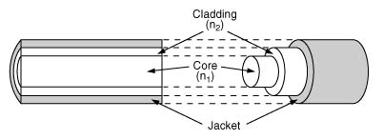
Typical Fiber Cross-section

Slide 30
Types of Fiber
Single Mode Fiber
  Core diameter is 2 to 8 µm
  Designed to carry only a single light ray
Multimode Fiber
  Core diameter is 50 to 200 µm
  Designed to carry multiple light rays or modes
  Step-index or Graded-index
When compared to single mode, multimode is less expensive and easy to terminate but it has lower capacity and is less efficient

Slide 31
Light Propagation through Fiber
Reflection
  Occurs when light bounces back in the same medium
Refraction
  Occurs when light changes speed as it travels in the second medium
  Refractive Index (n) is the ratio between the speed of light in free space and the speed of light in the medium

Slide 32
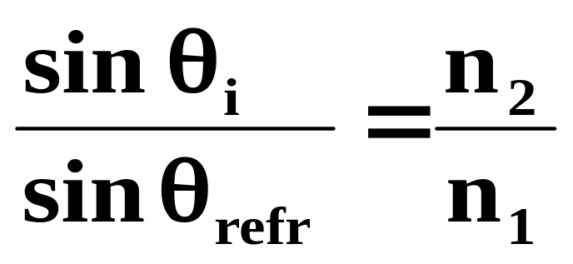
Total Internal Reflection
Total Internal Reflection
  When n₁>n₂, and incidence angle increases past the critical angle, light is reflected at the interface and does not enter the second medium
Snell’s Law

Slide 33
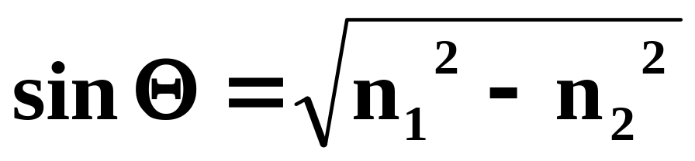
Numerical Aperture
Numerical Aperture is the sine of the acceptance angle
It is the light gathering ability of an optical fiber

Slide 34
Optical Sources and Detectors
In fiber-optics, attenuation varies with the wavelength of light. There are three low-loss windows:
  850 nm, 1300 nm and 1550 nm
Examples of optical sources
  LED and laser diodes
Example of optical detectors
  Photodiodes

Slide 35
Optical Detectors
Two types of optical detectors are widely deployed:
Positive-Intrinsic-Negative (PIN) photodiode
  In a PIN photodiode, light is absorbed and photons are converted to electrons in a 1:1 relationship
  PIN photodiodes are low cost but less efficient
Avalanche Photodiode (APD).
  APDs are similar devices, but provide gain through an amplification process ― one photon releases many electrons.
  APDs although more expensive have higher sensitivity and accuracy

Slide 36
Construction of a
Fiber-Optic Cable
Typical fiber-optic cable
  One or many fibers, coating, buffer tube, strength member and an outer jacket
Loose Buffer
  Allows fiber to move inside
  Applications in outside installations
Tight Buffer
  Small cable diameter, smaller bend radius, and greater flexibility
  Applications in indoor installations

Slide 37
Joining Fibers
Splice
  Welds, glues or fuses two ends of a fiber
  Permanent joint
Connectors
  Nonpermanent joints
Couplers
  Split information in many directions
A single mode fiber is more difficult to splice or connect as compared to a multimode fiber

Slide 38
Transmission Impairments in Fiber-Optic Cables
Dispersion
  Pulse broadening or spreading of light
  Material dispersion: depends on the dopants of the core glass
  Modal Dispersion: different modes propagating at different speeds
Scattering
  Result of imperfections in the glass fiber as it is heated in the forming process
Absorption
  Result of atomic resonance in the glass structure
Bending Losses
  Result of improper installation

Slide 39
Structured Wiring
Structured Wiring is a cabling system that meets strict installation standards to protect the integrity of the cabling system and to eliminate the need for constant re-cabling with the addition of each new application.
Prior to structured wiring, there were no strict distance limitation, no pathway constraints, and no closet requirement. It was very simple to install new telecommunication cabling.

Slide 40
Advantages of Structured Wiring
Promotes an efficient and economical wiring layout that technicians can easily follow
Standardized layout and documentation enhances the detection and isolation of problems
Ensures compatibility with future equipment and application

Slide 41
Three Main Elements of Wiring
Backbone Wiring
  Connection between the Telecommunications Room (TR) and equipment room within the building, and
  Connection between buildings
Horizontal Wiring
  Connection between the work area and the termination in the TR
Work Area Wiring
  Connection between a user station and the outlet

Slide 42
Centralized Cabling
The idea of Centralized Cabling is to connect the user directly from the desktop or workgroup to the centralized network electronics.

Slide 43
Fiber Zone
Is a combination of collapsed backbone and a centralized cabling scheme
Utilizes low-cost, copper-based electronics for Ethernet data communication while providing a clear migration path to higher speed technologies
Like centralized cabling, fiber zone cabling schemes, have one central Main Distribution Center (MDC)

Slide 44
Cable Facilities Hardware
The cable installation hardware is used to organize and control the placement of cable in a facility
Three types of Facilities Hardware
  Conduit
  Relay Rack
  Patch Panel
Notes:
Conduit- a pr-installed plastic or metal pipe that runs between or through buildings to ease cable installation. The diameters range from .5 to 6 inches depending on the application. It is commonly used to provide readily accessible paths for cabling between floors through firewalls, and around structural supports. All conduits should contain pull-strings for cable installation.
Relay Rack- a metal frame that is used to secure and support network equipment. Most telecommunications devices are designed so they can be mounted directly in the relay rack or placed on shelves that are already set up in the rack. The racks are sometimes enclosed in Telecommunications closets or cabinets. This prevents unauthorized access to the equipment.
Patch Panel- a piece of cable termination equipment that connects raw cables to standard ports or connectors. This allows a single, manageable point of access for several cables. Patch panels are usually mounted in relay racks or in enclosed equipment cabinets. The front surface or faceplate of the patch panel provides a series of modular ports or connectors, depending on the media being connected.

Slide 45
Cable Installation
It is important to follow the EIA/TIA guidelines related to factors such as degree of twist, bend radius, and termination.
Pulling tension, bend diameter, fill ratios, separation from power circuits, grounding, termination techniques, and many other skills must be studied, practiced, and mastered.
The ANSI/TIA/EIA 568-B published in March 2001, replaces the current standards document ANSI/TIA/EIA 568-A dated October 1995.

Slide 46
Updates in ANSI/TIA/EIA 568-B
CAT 5 is no longer recognized, and has been replaced by CAT 5E
The term Telecommunications Closet has been replaced with Telecommunications Room. The Telecommunications Room (TR) is generally the connection point between the building backbone cable and the horizontal cable.

Slide 47
T568A and T568B
T568A and T568B are the two wiring standards for an 8-position modular connector
The only difference between T568A and T568B is that the orange and green wire pairs (pairs two and three) are interchanged
T568B is commonly used in commercial installations, while T568A is prevalent in residential installations

Slide 48
Patch Cable versus Cross-Connect
A patch cable is a twisted-pair or fiber optic jumper cable that is straight-through, which means that pin one of the plug on one end is connected to pin one of the plug on the other end
  Used to connect a computer to a network or a hub to a distribution panel
A Crossover cable crosses the transmit and receive pairs which are the orange and green pairs in standard cabling
  Used to connect two Ethernet devices directly together without a hub. This can be two computers connected without a hub, or two hubs via standard Ethernet ports in the hubs

Slide 49
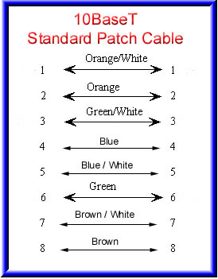
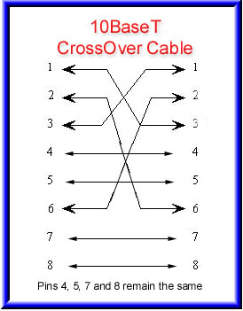
Pin Connections for
Patch Cable versus Cross-Connect

Slide 50
EIA/TIA Cable Testing Standards
Every cable tester is required to run a suite of four tests:
  Length
  Next
  Wire map
  Attenuation
Notes:
Length is tested by using a time domain reflectometer (TDR), which transmits a pulse down the cable and measures the elapsed time until it receives a reflection from the far end of the cable.
Next is measured from both ends.
Wiremap checks for open, short, crossed pair, reversed pair, and split pair and verifies a match between the pin and the connector pairs on either end of the link.
All testers verify the max. attenuation value, as defined in the specification, is not exceeded. Failure usually is caused by a kink or bend in the cable , poor termination, or a cable grade that is unsuitable for the data rate.

